Slide 1
APPLIED DATA SCIENCE WORKSHOP SERIES
Working with Real
Public Data
APIs, Data Quality, and Reproducible Data Pipelines
Presenter : Terri-Ann Grant
Data Science Graduate Specialist
Contact: terrianngrant@scarletmail.rutgers.edu
WEEK 5
Graduate Data Scientist | Applied Data Science Workshop

Slide 2
Learning Objectives
By the end of this workshop, participants will be able to:
AP
Explain what an API is and how it works
RE
Retrieve data from a public API
JS
Convert JSON data into a usable dataset
DQ
Identify common data quality issues
AG
Remove aggregate records from datasets
VL
Validate datasets before analysis
VZ
Create basic exploratory visualizations
RP
Document a reproducible workflow

Slide 3
Why Public Data Matters
Open data drives better decisions across every sector
PUBLIC DATA POWERS
COMMON SOURCES
Government decision making
WB
World Bank
Development indicators for 200+ countries
Economic analysis
CB
U.S. Census Bureau
Population, housing, and economic data
Public health research
WHO
World Health Organization
Global health statistics and indicators
Infrastructure planning
OSM
OpenStreetMap Foundation
Environmental monitoring
Open geographic and infrastructure data

Slide 4
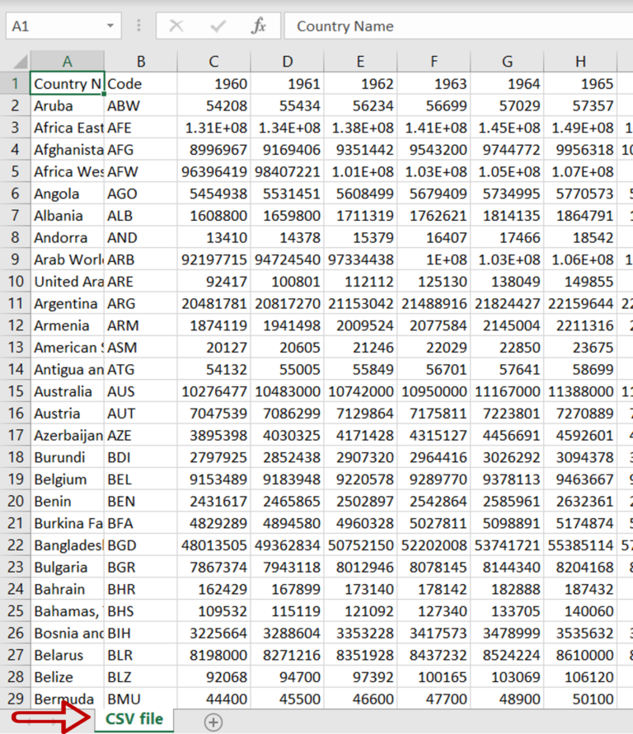
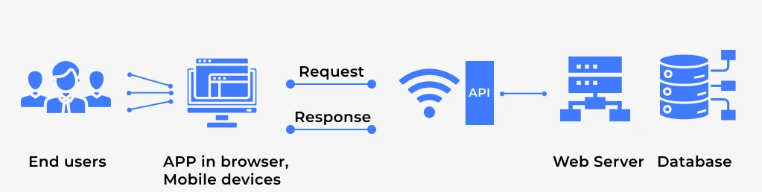
What Is an API?
Application Programming Interface
API = Application Programming Interface
An API allows one system to request information from another — like a waiter taking your order to the kitchen and bringing back the meal.
INSTEAD OF
WE CAN
Downloading CSV files manually
from a website each time data
is updated
Retrieve live, up-to-date data programmatically —
in one line of code

Slide 5
API Workflow
From request to insight — the full pipeline
RETRIEVE
PROCESS
OUTPUT
1
2
3
4
5
6
7
API
Request
›
JSON
Response
›
Data
Frame
›
Clean
›
Validate
›
Analyse
›
Visualize
Send a URL request
to the World Bank
API endpoint
Receive structured
JSON data back
from the server
Parse JSON into
a Pandas table
for analysis
Handle missing
values and fix
data types
Run checks:
counts, types,
aggregates
Summarise,
group, and
compare data
Create charts
that reveal
patterns
Key Point: Data analysis begins before visualization — every step in the pipeline prepares the next. Skipping steps leads to unreliable results.

Slide 6
Workshop Case Study
Digital infrastructure and broadband access
WORLD BANK INDICATOR
RESEARCH QUESTION
Fixed Broadband Subscriptions
per 100 People
Indicator Code:
How does broadband access vary across countries?
IT.NET.BBND.P2
Data source: World Bank Open Data API
Coverage: 200+ countries · Yearly records · 1990–present
And does it relate to income level?
We will use this dataset throughout the entire workshop.

Slide 7
Understanding JSON
JavaScript Object Notation — the language APIs speak
EXAMPLE STRUCTURE
JSON CONCEPTS
{
"country": "Jamaica",
"year": 2023,
"value": 15.2
}
Key
A label that identifies the data (e.g. "country")
Value
The actual data point (e.g. "Jamaica")
Object
A set of key-value pairs enclosed in { }
List
A collection of objects enclosed in [ ]
In this workshop, API responses come as JSON. We convert them to a Pandas DataFrame (a table ) so we can filter, sort, and analyze the data.

Slide 8
Converting JSON to DataFrames
Turning API responses into structured data for analysis
WHY USE DATAFRAMES?
DEMONSTRATION
They allow structured, reproducible data operations:
1. Call the World Bank API
F
Filtering
Select rows that meet a condition
2. Receive JSON response
S
Summarization
Group and aggregate values
3. Parse nested JSON structure
V
Visualization
Pass directly to plotting libraries
4. pd.DataFrame(records)
ST
Statistical analysis
5. Inspect with .head() and .info()
Mean, median, correlation, and more

Slide 9
Real World Data Problems
Public data is rarely ready to analyse straight from the source
Missing values
Incorrect data types
MV
Gaps where no measurement was recorded
DT
Numbers stored as strings, dates as objects
Duplicates
Outliers
DP
The same record appearing more than once
OL
Extreme values that skew results
Placeholder codes
Aggregate records
PC
Values like -99 or 'N/A' disguised as data
AR
Regional or global totals mixed with country rows
Can we trust every row? → Not until we check.

Slide 10
Hidden Problem: Aggregates
The World Bank API mixes countries with regional and global totals
The World Bank API includes these non-country records alongside real country data:
World
High Income
Low Income
Middle Income
Europe & Central Asia
Latin America & Caribbean
Sub-Saharan Africa
South Asia
These are NOT countries. Leaving them in will distort any analysis.

Slide 11
Why Aggregates Are Dangerous
A single bad row can invalidate an entire analysis
EXAMPLE
THE RULE
Suppose we calculate:
Average broadband access across all rows
If World is included as a row:
Always verify what
each row represents
before you calculate
anything.
Jamaica
15.2
Canada
43.1
"World"
17.8 ← distorts mean
One misunderstood row
can make the whole
analysis wrong.
Rule: Always verify what each row represents.

Slide 12
Metadata to the Rescue
Use the World Bank's own metadata to identify non-country records
WORLD BANK COUNTRY METADATA CONTAINS
THE KEY FIELD
Country Code
2- or 3-letter ISO identifier
When the Region field equals:
Country Name
Full display name
Region == "Aggregates"
Region
…the row is NOT a country.
We can filter these out
before any analysis begins.
Geographic region — or 'Aggregates'
Income Group
High / Middle / Low income classification
Lending Type
IDA, IBRD, or Not classified
This single field is the most reliable way
to identify non-country rows in the dataset.

Slide 13
Data Validation Workflow
A repeatable process for every new dataset
1
Retrieve Data
requests.get(url).json()
Call the World Bank API and load the raw JSON response into Python.
↓
2
Inspect Structure
df.head() | df.info()
Understand the shape of your data before touching anything.
↓
3
Check Missing Values
df.isnull().sum()
Count nulls per column — decide whether to drop, impute, or flag.
↓
4
Remove Aggregates
df[df.region != 'Aggregates']
Filter out rows where Region == 'Aggregates' using the metadata join.
↓
5
Validate Counts
df.nunique() | df.shape
Confirm expected number of countries, years, and total rows.
↓
6
Analyze
Ready to analyse
Proceed with a clean, validated dataset — every result is now trustworthy.
Treat this as a checklist — run it on every new dataset before drawing any conclusions.

Slide 14
Validation Checks
Five questions to ask before any analysis
Before analysis, ask yourself:
?
Do I know the Number of records?
Use
Use len(df) or df.shape[0]
?
Do I know the Number of countries?
df['country'].nunique()
df['country'].nunique()
?
Do I know the Number of years?
df['year'].nunique()
df['year'].nunique()
?
Do I know the Missing values?
df.isnull().sum()
df.isnull().sum()
?
Do I know the Data types correct?
df.dtypes
df.dtypes — year should be int, value float
Never skip validation. A clean dataset is the foundation of trustworthy analysis.

Slide 15
Exploratory Visualization
Understanding the distribution of broadband access
HISTOGRAM EXAMPLE
QUESTIONS TO ASK
Distribution of Broadband Access
Across All Countries
Is the distribution skewed?
Are there extreme values?
Are there clusters?
0% 20% 40% 60% 80%+
What does the peak tell us?
Broadband Subscriptions per 100 People
What is the typical country's access rate?

Slide 16
Broadband by Income Level
Does income predict broadband access?
BOXPLOT VISUALIZATION
RESEARCH QUESTION
Do higher income countries generally have greater broadband access?
Broadband per 100
What does the boxplot tell us?
→ Range of values per group
→ Median access rate
→ Spread and overlap between groups
High Income
Upper Middle
Lower Middle
Low Income

Slide 17
From Data to Insight
Numbers become useful when they are interpreted
EXAMPLE INSIGHT
"High income countries generally show higher broadband subscription rates than lower income countries, suggesting that economic resources drive digital infrastructure investment."
WH
WM
NX
What happened
Why it matters
What should happen next
State the finding clearly — what does the data show?
Connect the finding to a real-world consequence.
Suggest a question, action, or area for further study.
Good analysts explain all three.

Slide 18
Reflection Questions
Consolidate your thinking from today's workshop
Why remove aggregate records?
1
What goes wrong if you leave them in?
Why isn't country code length alone enough to filter them out?
2
Think about what codes like 'WLD' or '1W' look like
What role does metadata play in data validation?
3
Where does the Region field come from?
What challenges arise when working with public data?
4
Think about coverage, timeliness, and definitions
How might poor data quality affect policy decisions?
5
Consider a government using this data to allocate broadband funding

Slide 19
Connection to Upcoming Workshops
Public datasets appear throughout the entire series
The skills you practised today feed directly into every remaining workshop:
3
4
6
Workshop 3
Workshop 4
Workshop 6
Visualization
Machine Learning
Capstone Project
Use cleaned public data to build publication-quality charts. Histogram, boxplot, and map-style visualizations.
Train a Random Forest model on the NJ digital equity dataset. Validation steps you learned today apply directly.
Choose your own public dataset, apply the full pipeline, and present your findings to the group.
Public datasets can be used in all three — and in your own independent projects.

Slide 20
KEY TAKEAWAYS
Session 5 — Working with Real Public Data
APIs provide live, programmatic access to public data
1
Public datasets require validation before any analysis
2
Metadata is critical for understanding what each row represents
3
Aggregate records must be identified and removed
4
Cleaning and validation are a core part of analysis
5
Reproducibility — document every step of your pipeline
6

